Slide 1
Investigating Volumetric Analysis of Constituents Of Brain Soft Tissue Presented by Daniyal Ahmed Gul (BCS223030) Muhammad Hasan Nauman (BCS223033) Hadia Khan (BCS223216)
Supervisor: Dr Masroor Ahmed
Department of Computer Sciences, Capital University of Science & Technology, Islamabad

Slide 2
Introduction -Problem & Significance
The Problem: Manual segmentation of brain tissues (Gray Matter, White Matter, CSF) is time-consuming, prone to human error, and computationally expensive.
Significance: Volumetric changes are key indicators for Alzheimer’s, Multiple Sclerosis, and brain tumors.
Project Goal: To develop an automated, data-driven framework using 2D MRI slices to estimate 3D tissue volumes with high precision.

Slide 3
Introduction - Proposed Methodology
THE PIPELINE Data Acquisition: Using public repositories like Kaggle, TCIA, and OASIS. Preprocessing: Cleaning data via Python (resizing, denoising, skull stripping).
Core Engine: Hybrid feature extraction (Texture, Shape, and CNN features) followed by PCA for reduction.
Final Output: Volumetric reports and tissue classification using K-Means and ML models.

Slide 4
Functional requirements
s.no | Functional Requirements | Type | Status
1 | Researcher registers and logs into the system | core | completed
2 | Researcher uploads MRI images to the system | core | completed
3 | Automated preprocessing pipeline | core | completed
4 | System extracts texture features and shape features | core | In progress
5 | System generates deep CNN features(MobileNet/EfficientNet-B0) | core | In progress
13 | System provides password recovery functionality | Intermediate | completed
14 | User logs out from the system | core | completed
6-12 | Remaining Tasks(PCA,Model Training,Volumetric Ratios) | various | pending

Slide 5
Development Coding Standards
Purpose: Ensures a readable, maintainable, and industry-aligned codebase for research reproducibility.
Indentation Rules:
Backend : 4 spaces per level.
Frontend : 2 spaces per level for standard JS/TS practice.
Declarations & Typing:
Backend: Explicit variable declarations and Python type hints.
Frontend: Strict TypeScript typing for all API responses and data structures.
Naming Conventions:
Snake_case: For Python functions and variables (e.g. perform_skull_stripping).
CamelCase: For Frontend functions and variables (e.g. processedImage).
PascalCase: For Classes and React Components.

Slide 6
Development Environment & Stack
OS: Windows-based environment.
IDE: Visual Studio Code.
Frontend: React and Next.js for a modern, component-based UI.
Backend: Python for heavy-duty MRI image processing (resizing, normalization, etc.).
Database: MongoDB with Mongoose for user/patient records.

Slide 7
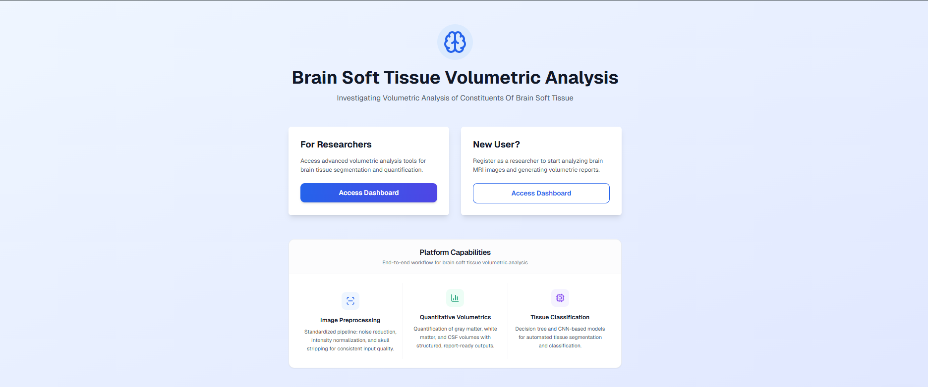
USER INTERFACE - LANDING PAGE
Key Features: Provides entry points for researchers and new users.
Highlights platform capabilities: Preprocessing, Volumetrics, and Classification.

Slide 8
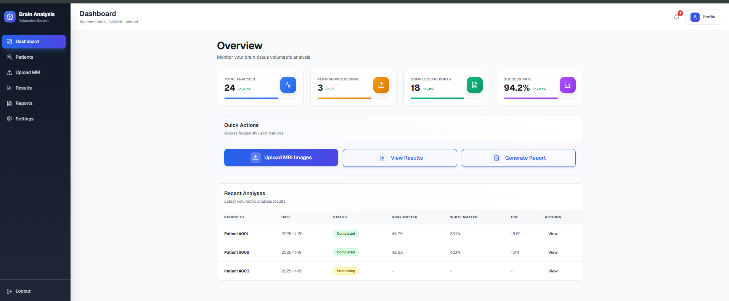
USER INTERFACE - DASHBOARD & AUTH
Functionality
Secure authentication using Bcrypt password hashing.
Dashboard provides "Quick Actions" for uploading images and generating reports.
Summary of total analyses and success rates.

Slide 9
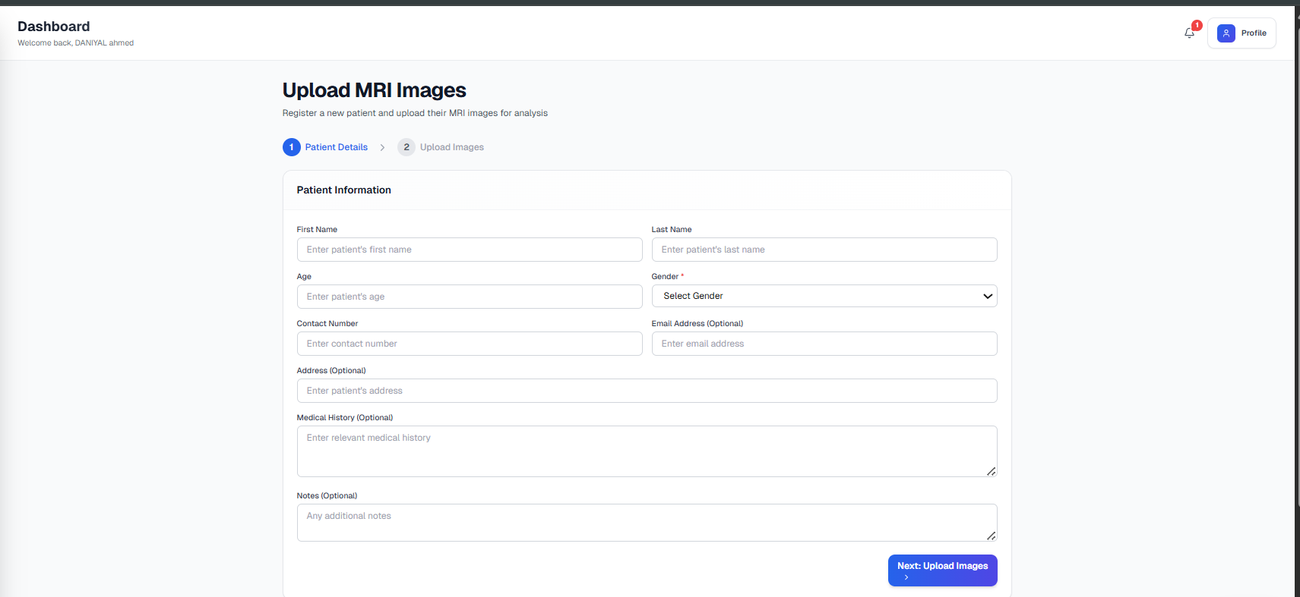
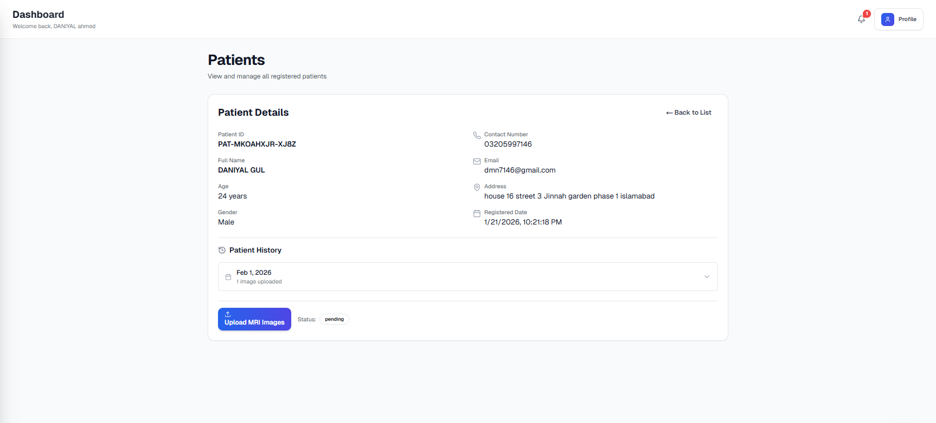
USER INTERFACE - MRI UPLOAD MODULE
Functionality
Link MRI images to specific patient records.
Supports multiple formats: JPG, PNG, DICOM, and NIfTI.
Backend processes images and saves them to a temporary server directory.

Slide 10
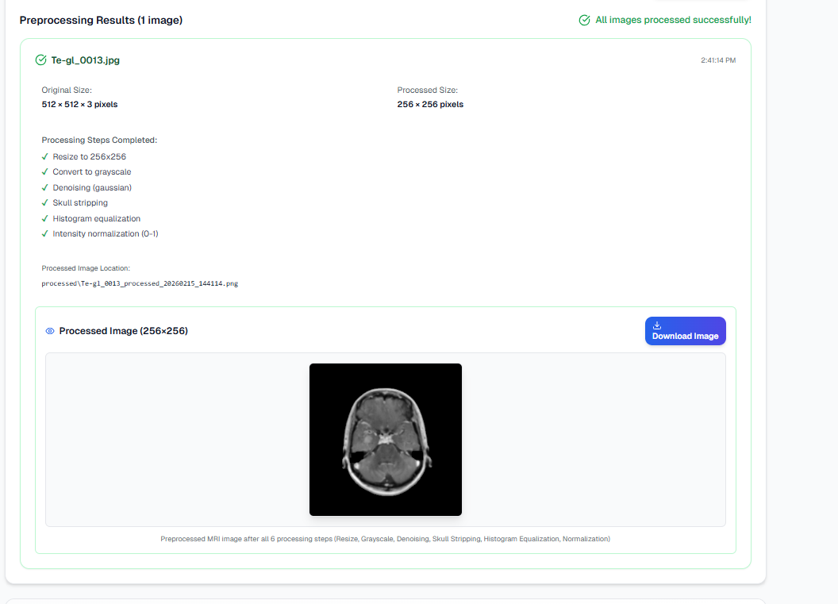
Backend Preprocessing Implementation
The fixed sequence of steps implemented
Resizing: Standardizing all inputs to 256x256 pixels.
Grayscale Conversion: For intensity-based analysis.
Denoising: Removing artifacts while preserving edges.
Skull Stripping: Removing non-brain tissue (skull/scalp).
Histogram Equalization: Enhancing contrast for clearer tissue boundaries

Slide 11
PREPROCESSING VISUALIZATION
Results
The UI provides immediate confirmation once all 6 preprocessing steps are completed.
Metadata regarding applied steps is returned via API for user verification.

Slide 12
Software Testing Methodology
Method: Black-Box Testing.
Reasoning: To validate functional behavior (inputs/outputs) from the user’s perspective without analyzing internal code.
Environment: Standard desktop system using a web browser to simulate real-world usage.
Focus: Correctness of image uploads, execution of preprocessing, and UI stability.

Slide 13
Key Test Cases (Authentication & Upload)
Test ID | Objective | Input | Status
TC-01 | Verify Sign-in | Valid Credentials | Pass
TC-02 | Invalid Login Handling | Wrong Password | Pass
TC-03 | MRI Image Upload | png / .jpg file | Pass
TC-04 | Invalid File Format | .pdf file | Pass

Slide 14
Key Test Cases (Preprocessing & UI)
Test ID | Objective | Expected Result | Status
TC-05 | Preprocessing Execution | Resized, denoised, and skull-stripped image | Pass
TC-06 | Output Visualization | Display processed data on UI without distortion | Pass
Conclusion: The initial 30% of the project (UI and Preprocessing) is stable and has passed all functional tests

Slide 15
Thank you

